Slide 1

CAP489 MOBILE APP DEVELOPMENT FRAMEWORKS

Slide 2
Topics Covered
Ionic framework introduction,
project structure,
different types of app in Ionic

Slide 3
Ionic framework introduction
https://ionic.io/framework
Ionic Framework is an open source UI toolkit for building modern, high performance cross-platform apps from a single codebase.
Ionic is an open source UI toolkit for building performant, high-quality mobile apps using web technologies — HTML, CSS, and JavaScript — with integrations for popular frameworks like Angular, React, and Vue.

Slide 4
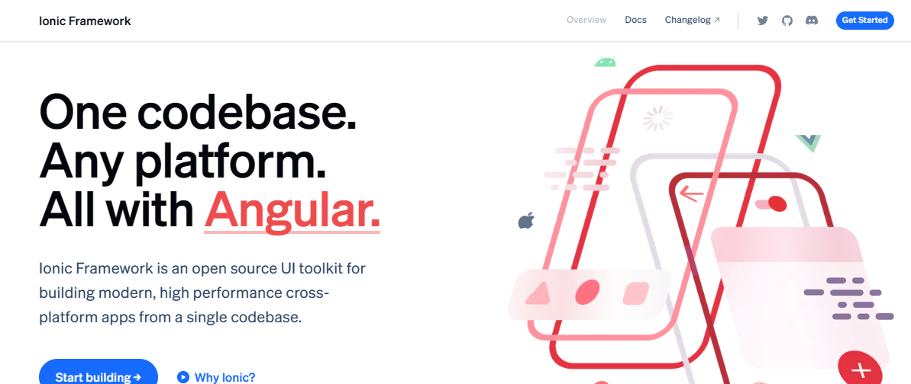

Slide 5
Ionic app
Ionic has three main/go-to templates using which we can quickly start developing apps:
Blank: This is a blank Ionic project with one page
Tabs: This is a sample app that is built using Ionic tabs
Side menu: This is a sample app that is built to consume side menu driven navigation

Slide 6
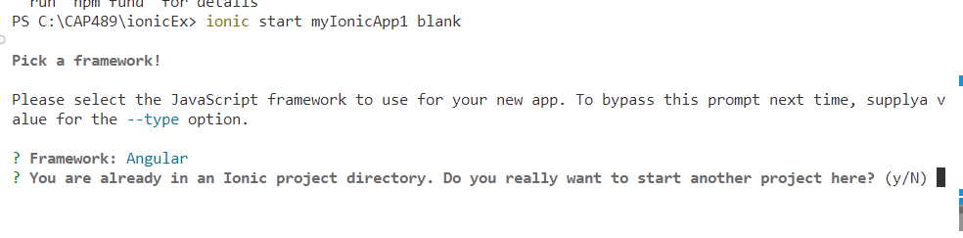
Install the Ionic CLI
npm install -g @ionic/cli
ionic start myIonicApp blank
If there was a previous installation of the Ionic CLI, it will need to be uninstalled due to a change in package name.
$ npm uninstall -g ionic
$ npm install -g @ionic/cli

Slide 7
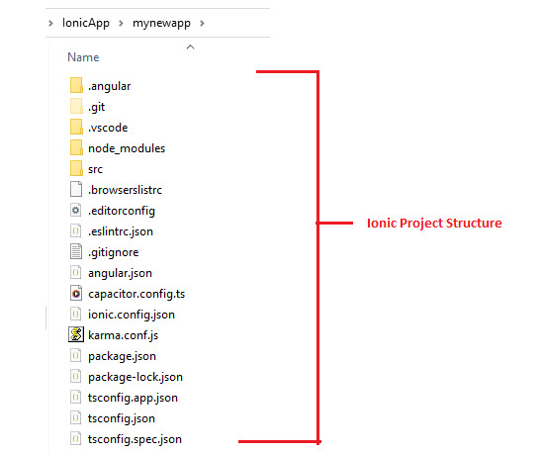
Project Structure

Slide 8
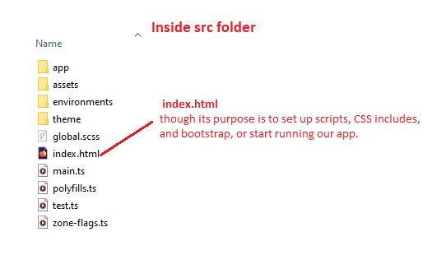

Slide 9
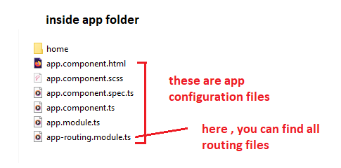

Slide 10
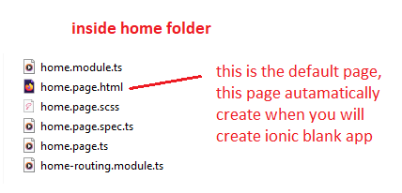

Slide 11
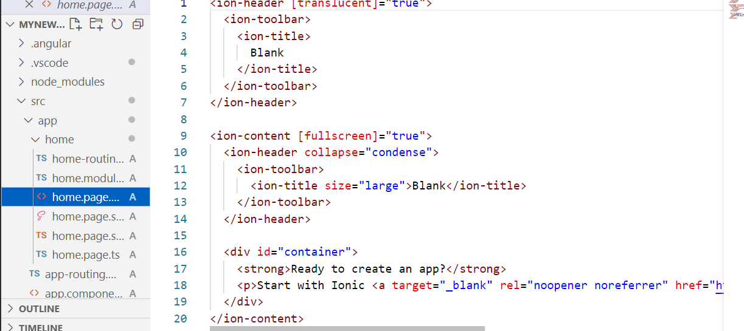

Slide 12
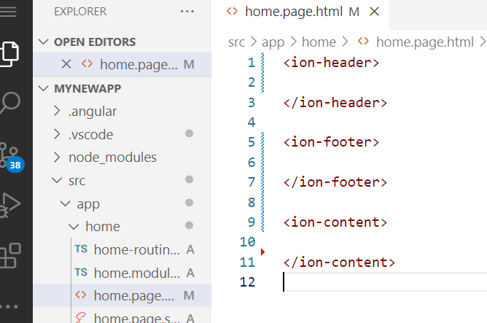

Slide 13
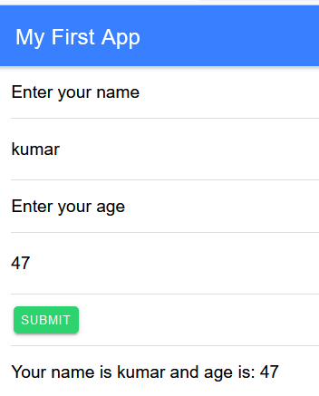

Slide 14
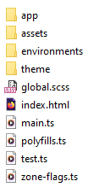
src
index.html is the main entry point for the app,
though its purpose is to set up scripts, CSS includes, and bootstrap, or start running our app.

Slide 15

Use capacitor
ionic integrations enable capacitor
Capacitor 3 was released 2 days ago, and your ionic cli version is not compatible with it, you need to update the ionic cli version
npm uninstall -g ionic
npm uninstall -g @ionic/cli
npm install -g @ionic/cli

Slide 16
Add android platform
ionic cap build android

Slide 17
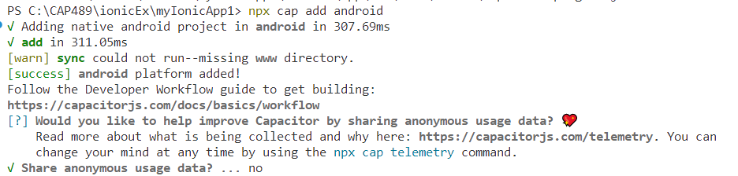
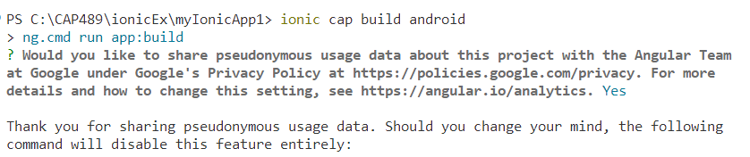

Slide 18
Capacitor
Capacitor is an open source cross-platform app runtime that allows web-based apps to run natively on iOS, Android, Electron, and the web. It's helpful to refer to these apps "Native Progressive Web Apps" and they represent the next evolution beyond the traditional Hybrid app mentality. Capacitor was created and is actively developed/supported by Ionic, the company.

Slide 19
Apache Cordova
Apache Cordova is an open source mobile application development framework that transforms standard HTML/CSS/JS into full-fledged native apps. It provides a JavaScript API for accessing native device functionality, such as the camera or accelerometer. Cordova contains the necessary build tools for packaging webapps for iOS, Android, and Windows Phone.

Slide 20
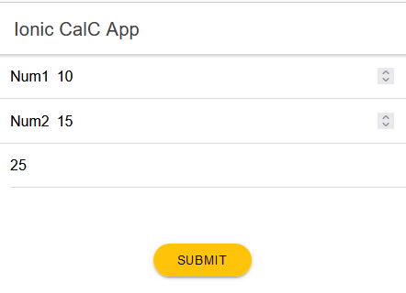

Slide 21
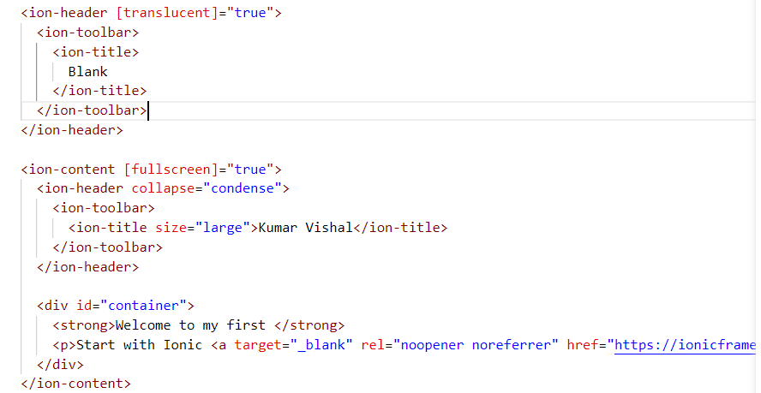
home.page.html

Slide 22
ion-header
Header is a root component of a page that aligns itself to the top of the page. It is recommended to be used as a wrapper for one or more toolbars, but it can be used to wrap any element.

Slide 23
<ion-header>
<ion-toolbar>
<ion-title>Header</ion-title>
</ion-toolbar>
</ion-header>

Slide 24
ion-toolbar
Toolbars are generally positioned above or below content and provide content and actions for the current screen. When placed within the content, toolbars will scroll with the content.
Toolbars can contain several different components including titles, buttons, icons, back buttons, menu buttons, searchbars, segments, progress bars, and more.

Slide 25
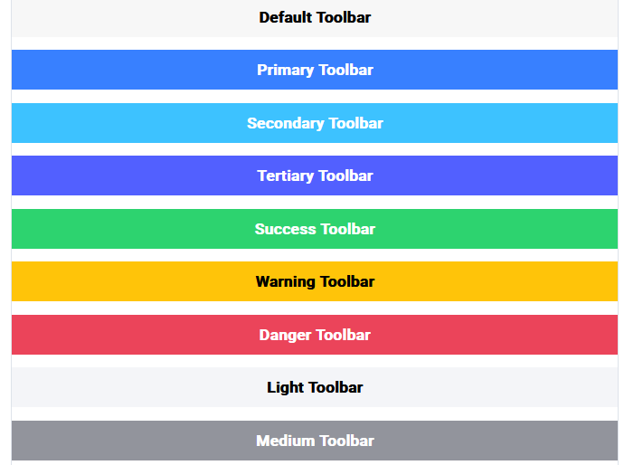
<ion-toolbar color="primary">

Slide 26
ion-header>
<ion-toolbar>
<ion-title>Header Toolbar</ion-title>
</ion-toolbar>
</ion-header>
<ion-footer>
<ion-toolbar>
<ion-title>Footer Toolbar</ion-title>
</ion-toolbar>
</ion-footer>

Slide 27
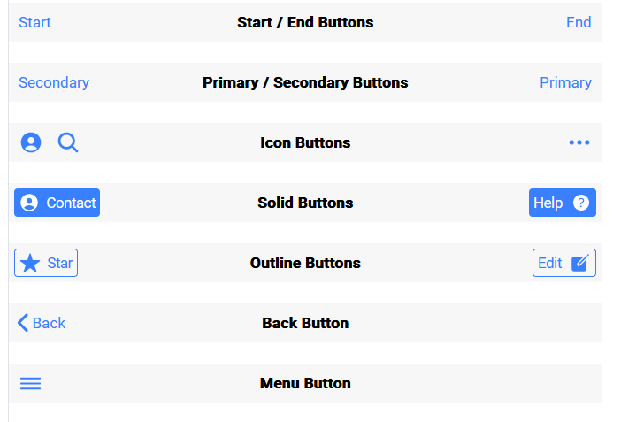

Slide 28
Searchbars in Toolbars​
A searchbar can be placed inside of a toolbar to search through the content. It should be the only child component of the toolbar, and will take up the full width and height.

Slide 29
<ion-toolbar>
<ion-searchbar></ion-searchbar>
</ion-toolbar>

Slide 30
Add pages in Ionic
Use command in Terminal:
ionic g page pageName
Here, g is generate

Slide 31
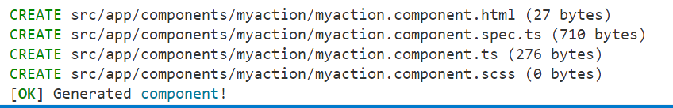
Add component in Ionic
Ionic apps are made of high-level building blocks called Components, which allow you to quickly construct the UI for your app.
To add component in your page:

Slide 32
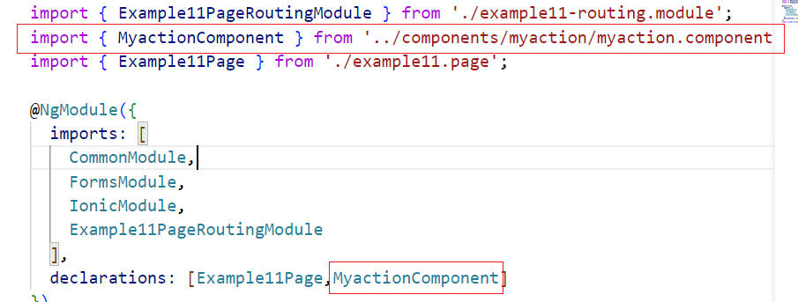
Step2:
Open any page:
For example if page name is example11 then open page example11.module.ts and import your component

Slide 33
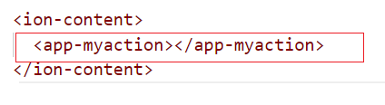
Step3:
Now open your page with .html and add your component tag:

Slide 34
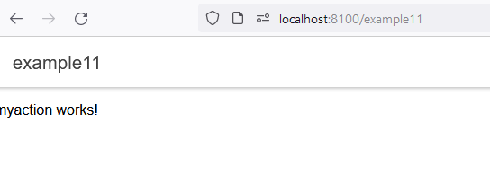
Now run your page

Slide 35
Steps to use API:
Step1: Open website for api and generate key
Step2:
Open file: environment.ts
Define variable API_KEY and API_URL:
export const environment = {
production: false,
API_KEY:'da7c2b524f5e452cb10dd4b388d19353', API_URL:'https://newsapi.org/v2/’
};

Slide 36
Step3: Open app.module.ts
Add HttpClientModule:
import { HttpClientModule } from '@angular/common/http’;
And Add HttpClientModule in imports statement
@NgModule({
declarations: [AppComponent],
imports: [BrowserModule, IonicModule.forRoot(), AppRoutingModule,HttpClientModule],
providers: [{ provide: RouteReuseStrategy, useClass: IonicRouteStrategy }],
bootstrap: [AppComponent],
})

Slide 37
Step4:open home.page.ts
Add HttpClient
import{HttpClient} from '@angular/common/http’;
Define : API_KEY and API_URL
const API_URL=environment.API_URL
const API_KEY=environment.API_KEY

Slide 38
Step5:Create object httpClient
constructor(public httpClient:HttpClient)
Step6: Define one method to load your api:
loadData()
{
this.httpClient.get<any>(`${API_URL}/weather?q=${"Jalandhar"}&&appid=${API_KEY}`).subscribe((results)=>
this.weatherTemp=results['main']
this.cityName=results['name']
console.log(this.weatherTemp)
} )
Call loadaData() inside constructor:
constructor(public httpClient:HttpClient) {
this.loadData()
}

Slide 39
Define these variables:
weatherTemp:any
todayDate=new Date()
cityName:any

Slide 40
Step7:
Now in html page:
<ion-item>
<p>Todays Report</p>
<ion-label slot="end">{{todayDate|date:"EEE dd MMM"}}</ion-label>
</ion-item>
<ion-item>
<span>
{{(weatherTemp?.temp-273.15).toFixed(0)}}
</span>
<span>o</span>
</ion-item>

Slide 41
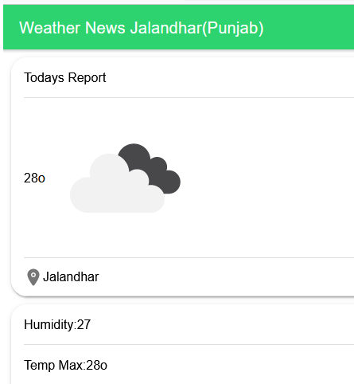
Run your app:

Slide 42
Note:
HttpClientModule: The HttpClientModule is a service module provided by Angular that allows us to perform HTTP requests and easily manipulate those requests and their responses.
It is available in package:
import { HttpClientModule } from '@angular/common/http';

Slide 43
To use HttpClient to make HTTP requests like GET & POST, etc. to the back end server.
The HttpClient is a separate model in Angular and is available under the @angular/common/http package.
Inject HttpClient service
Inject the HttpClient service in the constructor.
constructor(public http: HttpClient) {
}

Slide 44
Call the HttpClient.Get method
Use HttpClient.Get method to send an HTTP Request. The request is sent when we Subscribe to the get() method. When the response arrives map it the desired object and display the result.

Slide 45
What is Observable?
The Angular HTTPClient makes use of observable. Observable help us to manage async data. You can think of Observables as an array of items, which arrive asynchronously over time.

